Slide 1
BATTLE OF THE NEIGHBOURHOOD CAPSTONE PROJECT

Slide 2
Introduction/ Problem: In 2018 New York City welcomed a record 65.2 million visitors, comprising 51.6 million domestic and 13.5 million international visitors, the ninth consecutive year of tourism growth. However, given the constant flowing of visitors, the reviews in the most visited travel guide platform, Tripadvisor, on accessibility to information while travelling in New York is notoriously bad. So why do tourists have difficulty access to information?

Slide 3
So why do tourists have difficulty access to information?
And what should we do?

Slide 4
Python packages and Dependencies:
Pandas - Library for Data Analysis
NumPy – Library to handle data in a vectorized manner
JSON – Library to handle JSON files
Geopy – To retrieve Location Data
Requests – Library to handle http requests
Matplotlib – Python Plotting Module
Sklearn – Python machine learning Library
Folium – Map rendering Library

Slide 5
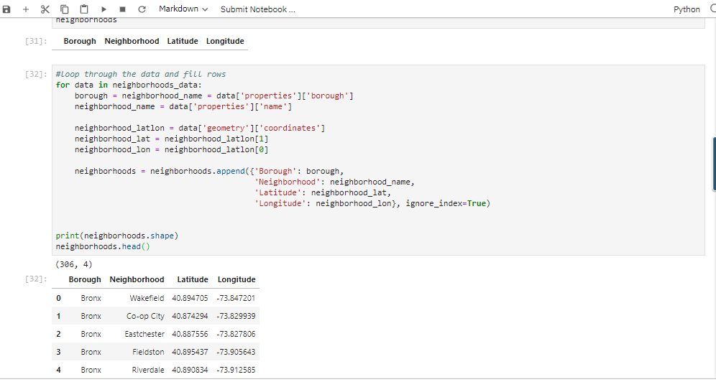
Pre-processing/ Data Wrangling

Slide 6
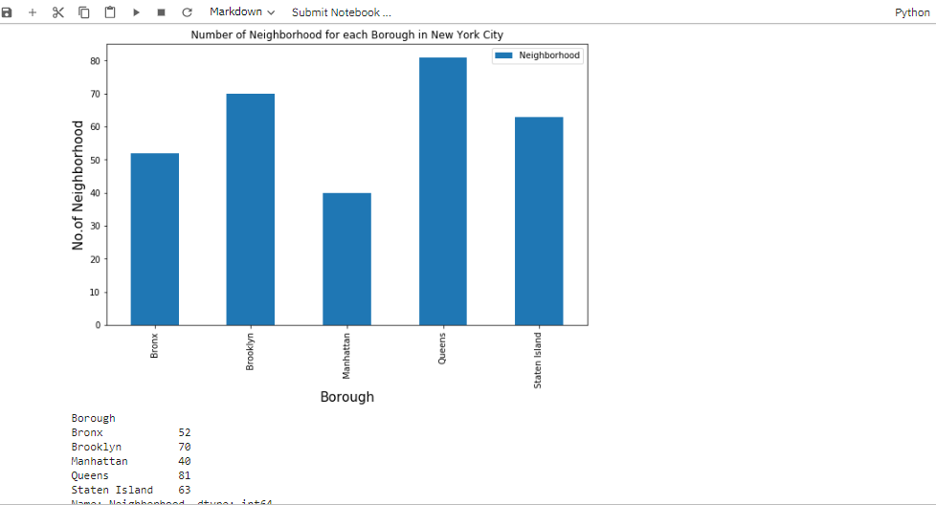
No. of Neighborhood in each Borough

Slide 7
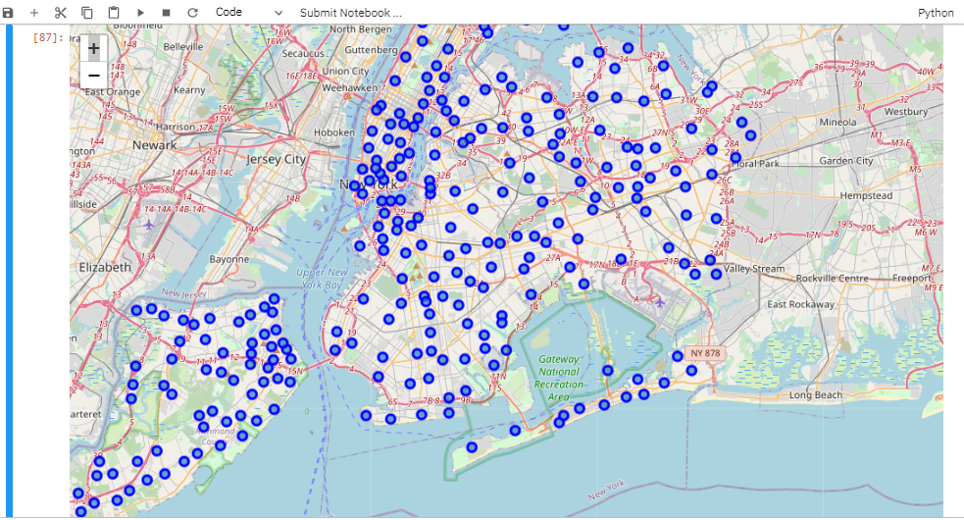
Search for all venues

Slide 8
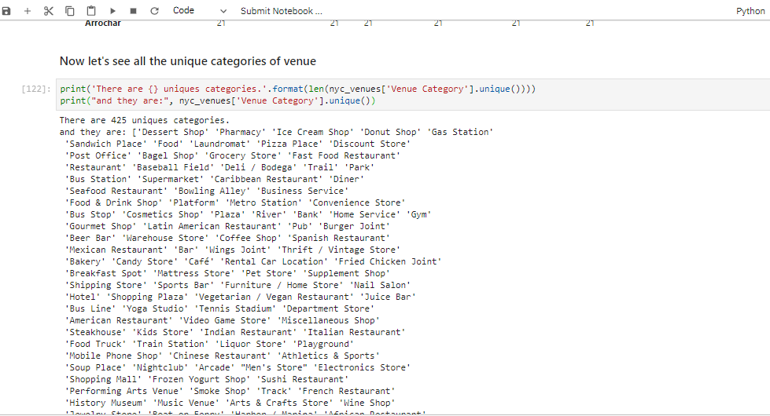
Search for Targeted Data/Value

Slide 9
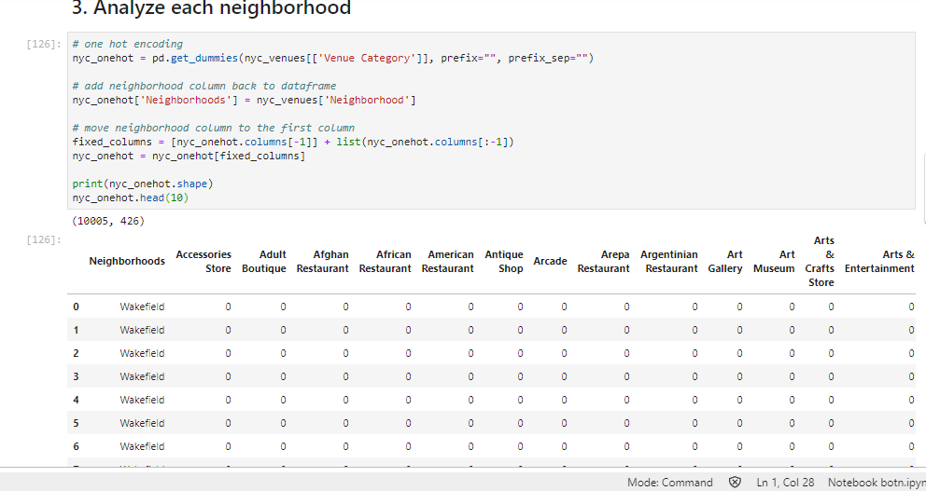
Analyse each neighborhood

Slide 10
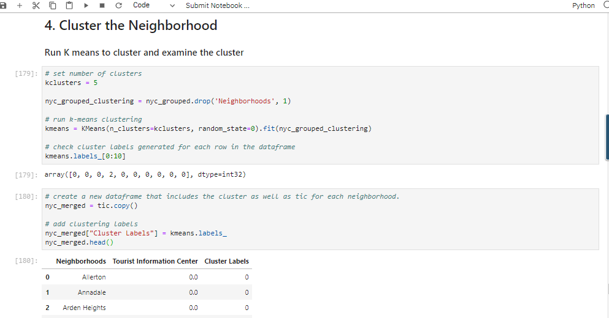
Finally cluster via kmeans

Slide 11
Conclusion
I found that there are only 2 official Tourist Information Center:
- in Manhatten
And – in Staten Island

